Slide 1
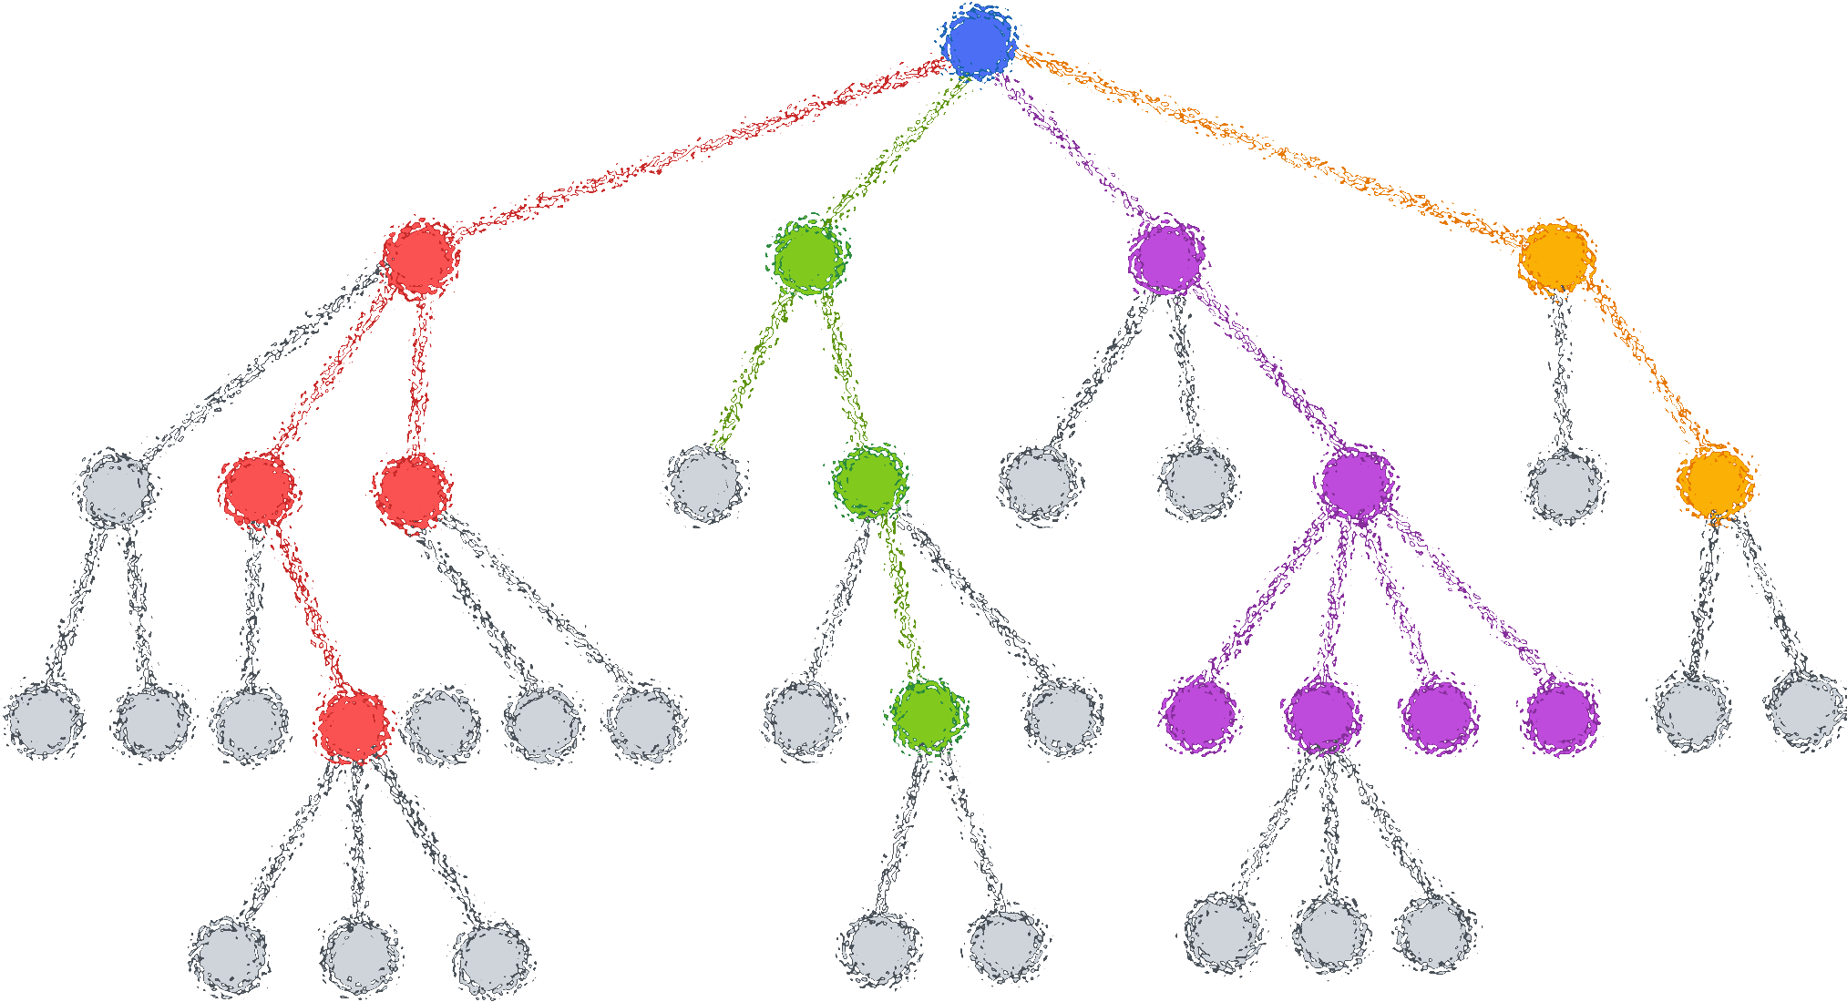

Lecture 11: Random Forest
CSE445 Machine Learning
Dr. Jilan Samiuddin (JSA)
Assistant Professor
North South University

Slide 2
Introduction
A Random Forest is an ensemble learning method and a supervised learning algorithm used for classification and regression tasks
It builds multiple decision trees and merges them to get more accurate and stable predictions
Random Forest = Many weak learners (trees) ➜ One strong model
Outcome: Lower overfitting + Higher accuracy + Greater robustness

Slide 3
Why random tree instead of a single decision tree?
✅ Reduces Overfitting:
Randomness in data and features helps reduce overfitting
Random forest averages multiple trees, reducing variance and improving generalization
✅ Improves Accuracy:
Aggregating predictions from many trees leads to more accurate and stable results
✅ Handles Noisy Data Better:
Random forests are robust to outliers and noise due to the ensemble effect
✅ Works Well with High-Dimensional Data:
Random feature selection at each split makes it effective even when many features are irrelevant
✅ Less Sensitive to Training Data Fluctuations:
Small changes in training data drastically affect decision trees
Random forests average out such inconsistencies
✅ Handles Missing Data:
Can make accurate predictions even with incomplete data

Slide 4
Limitations of Random Forest
Slower to predict than individual decision trees
Less interpretable compared to a single tree
May not perform well on sparse or very high-dimensional data.

Slide 5
Ensembling
Uses multiple small models instead of a single complex one
Each model is weak or not highly accurate on its own
Combines results to produce a stronger overall prediction
Reduces errors by averaging out individual model weaknesses
Similar to taking advice from a group rather than one person – group consensus usually leads to a more reliable outcome
Two main types:
Bagging (Bootstrap Aggregating): Reduces variance by training models on random subsets of data
Boosting: Reduces bias by sequentially improving models
Random Forest uses bagging with decision trees

Slide 6
How Random Forest Works?
Bootstrap Sampling
Create N random subsets from training data (with replacement)
Ensures diversity and reduces class imbalance
Base Model Training
Train independent base models on each subset
Models run in parallel to save time
Can use different base learners for more robustness
Prediction Aggregation
Combine outputs from all base models
Use majority voting (classification) or averaging (regression)
Out-of-Bag (OOB) Evaluation
Use unselected samples to estimate performance
Final Prediction
Output from aggregated predictions of all models

Slide 7
Example: Heart Disease
Original Dataset
ChestPain | Good Blood Circ. | Blocked Arteries | Weight | Heart Disease
No | No | No | 125 | No
Yes | Yes | Yes | 180 | Yes
Yes | Yes | No | 210 | No
Yes | No | Yes | 167 | Yes
First, we create the bootstrapped dataset – same size as original
Randomly select from the original
Allowed to pick the same sample more than once for the same bootstrapped dataset
Credit: StatQuest

Slide 8
Step 1: Bootstrapped Dataset
Original Dataset
Bootstrapped Dataset
Chest Pain | Good Blood Circ. | Blocked Arteries | Weight | Heart Disease
No | No | No | 125 | No
Yes | Yes | Yes | 180 | Yes
Yes | Yes | No | 210 | No
Yes | No | Yes | 167 | Yes
Chest Pain | Good Blood Circ. | Blocked Arteries | Weight | Heart Disease
Yes | Yes | Yes | 180 | Yes
No | No | No | 125 | No
Yes | No | Yes | 167 | Yes
Yes | No | Yes | 167 | Yes
Randomly
selected

Slide 9
Step 2: Decision Tree
Create a decision tree using the bootstrapped dataset
BUT, only use a random subset of features at each step
Instead of the 4 features, we randomly select, e.g., the 2nd and the 3rd features, i.e., these are the features used in the root node
Bootstrapped Dataset
Chest Pain | Good Blood Circ. | Blocked Arteries | Weight | Heart Disease
Yes | Yes | Yes | 180 | Yes
No | No | No | 125 | No
Yes | No | Yes | 167 | Yes
Yes | No | Yes | 167 | Yes

Slide 10
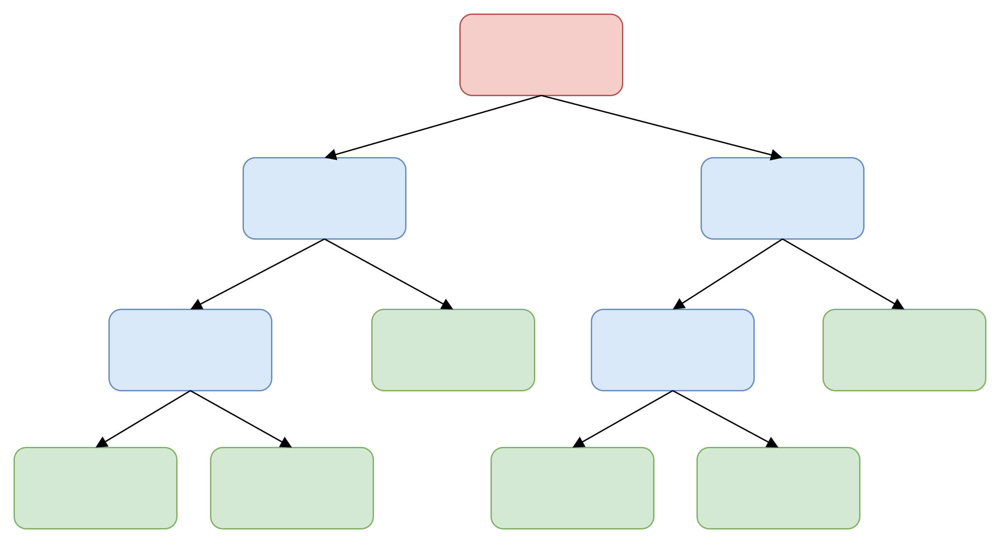
Step 2: Decision Tree (contd.)
We have our first decision tree
Bootstrapped Dataset
Chest Pain | Good Blood Circ. | Blocked Arteries | Weight | Heart Disease
Yes | Yes | Yes | 180 | Yes
No | No | No | 125 | No
Yes | No | Yes | 167 | Yes
Yes | No | Yes | 167 | Yes

Slide 11
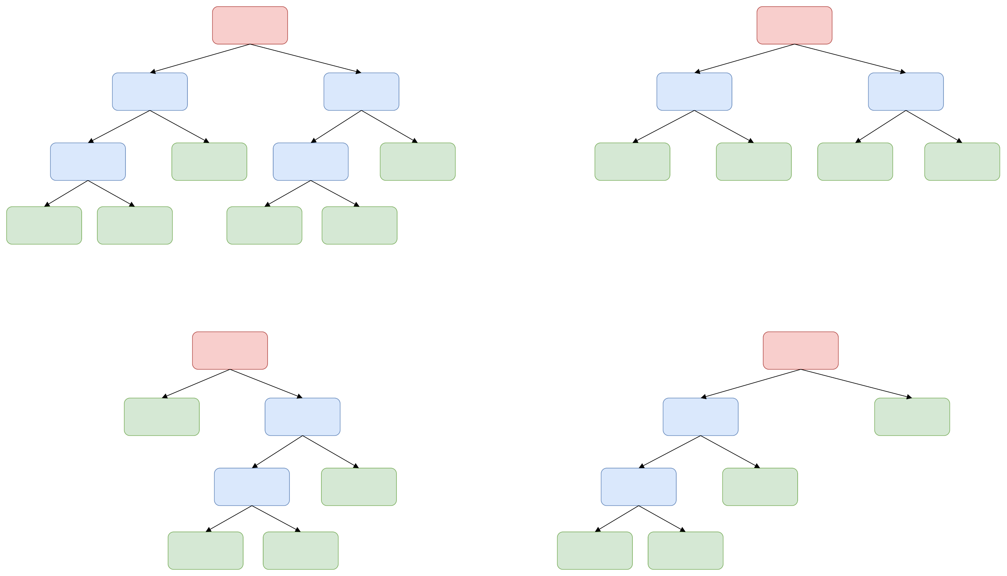
Step 3: Repeat Step 1 and Step 2
Create more decision trees by making new bootstrapped dataset and building a tree considering a subset of features at each step
Ideally, you would do it hundreds of times
This will result in varieties of trees making random forest more effective

Slide 12
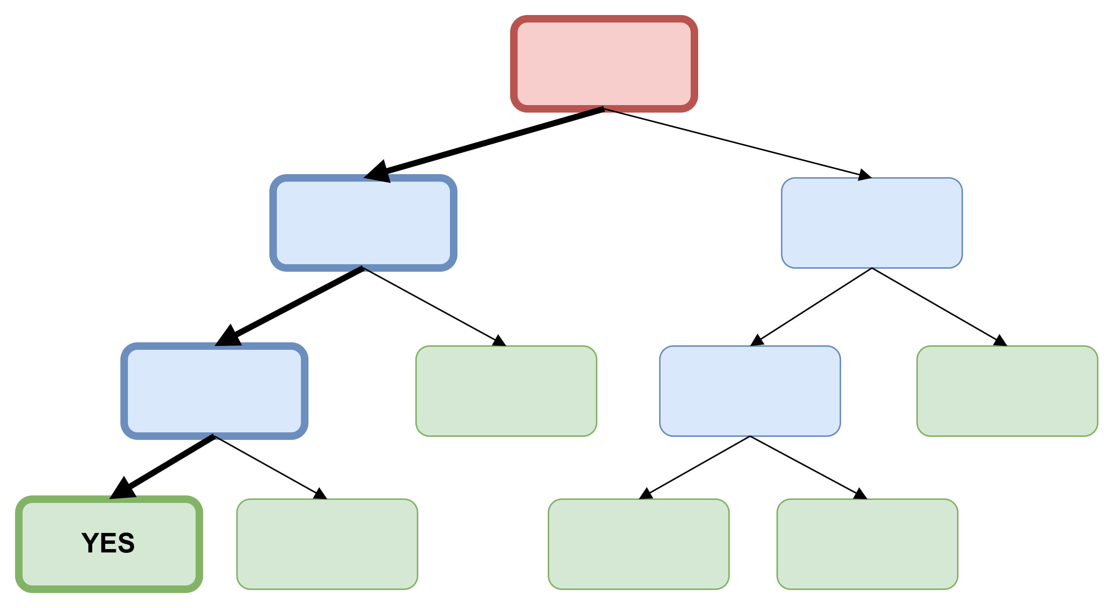
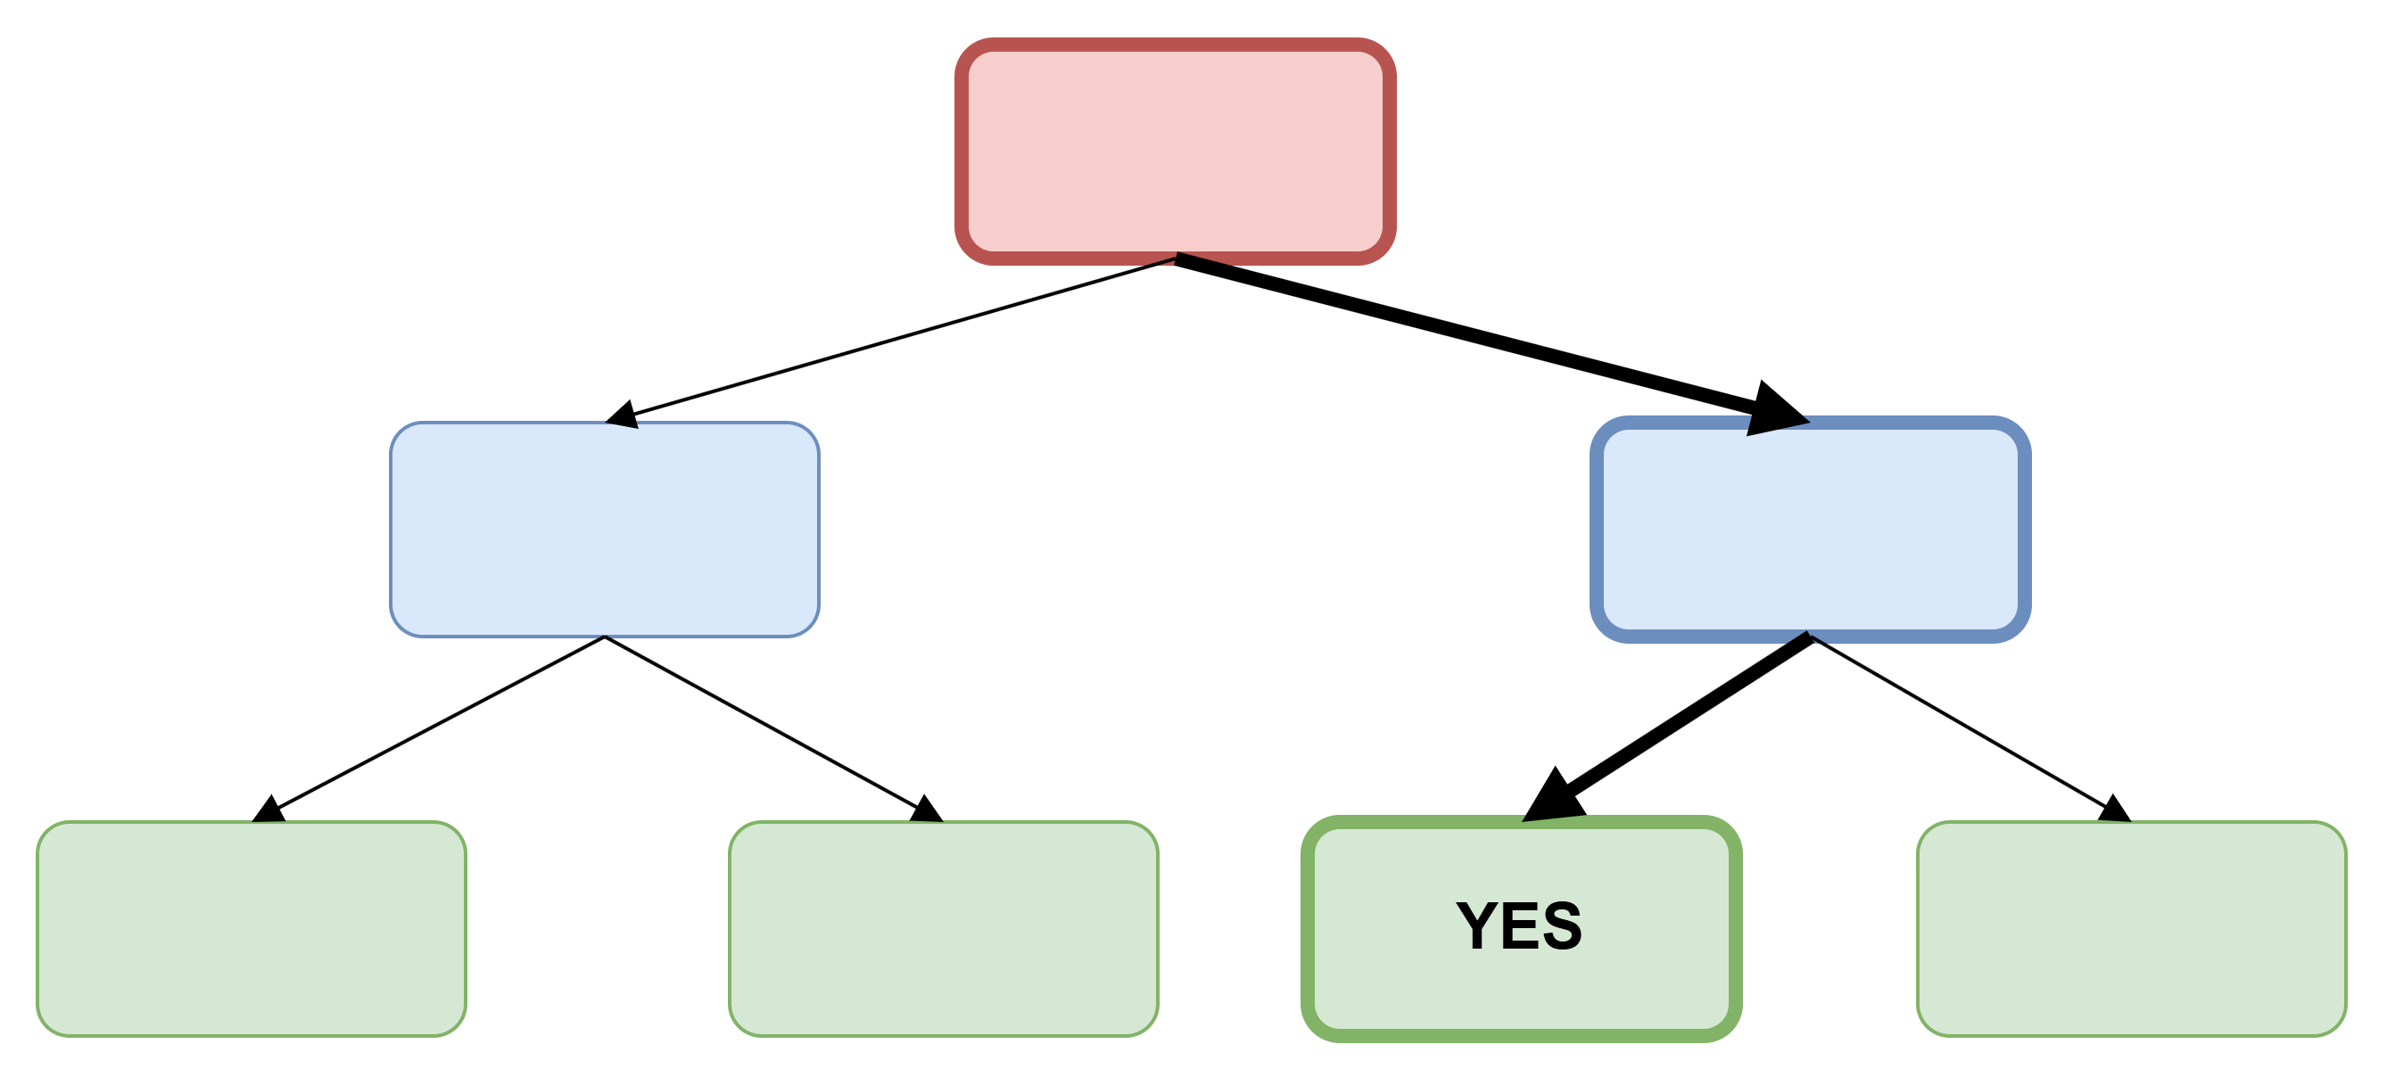
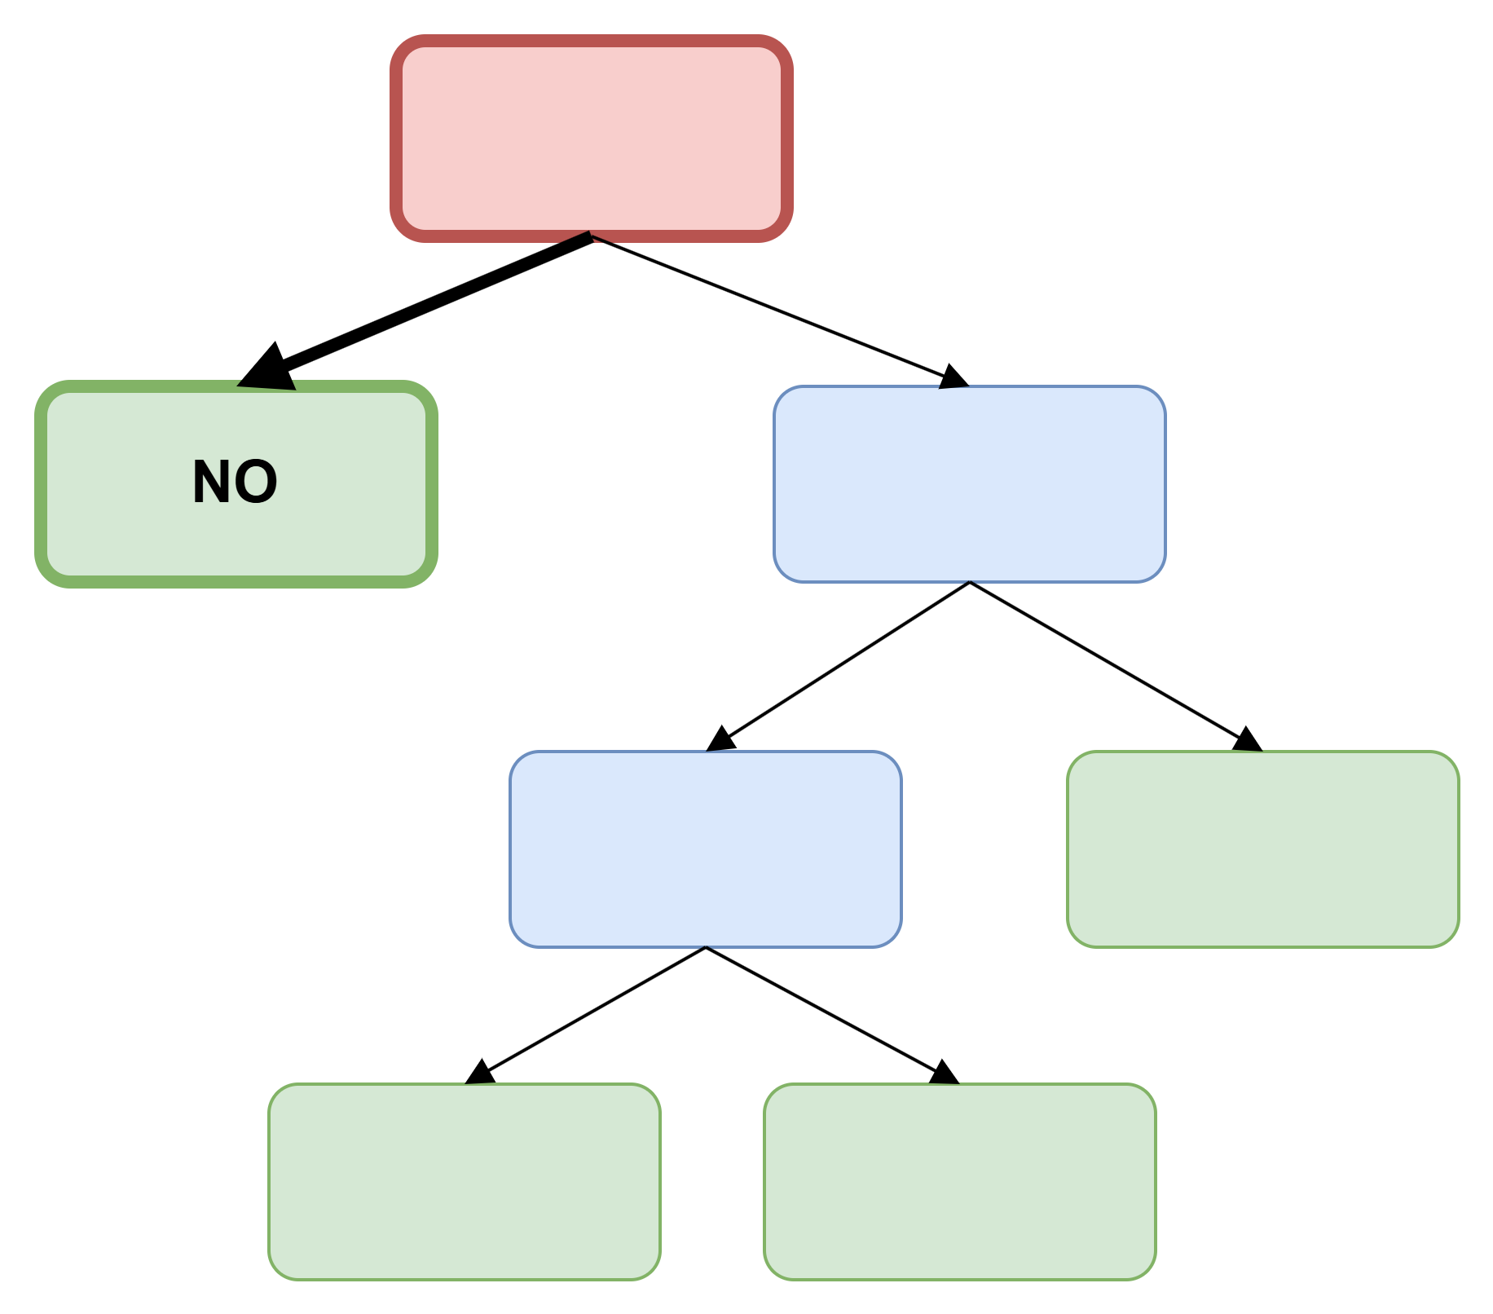
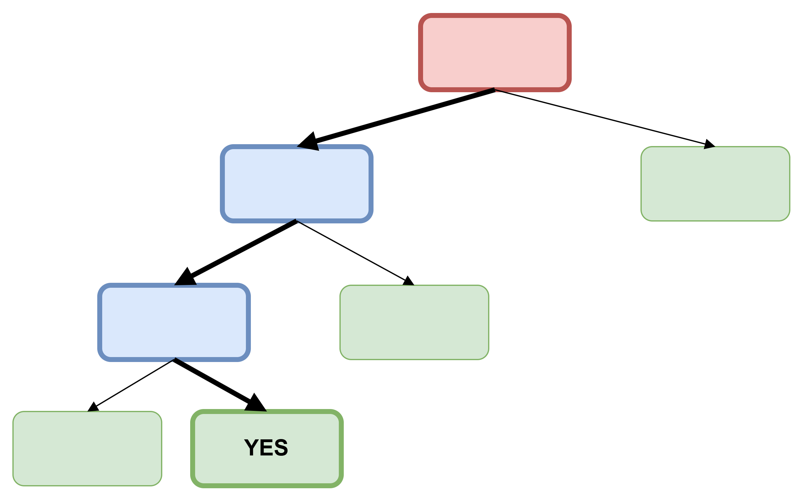
Making Prediction
Heart Disease
Yes | No
3 | 1
Chest Pain | Good Blood Circ. | Blocked Arteries | Weight | Heart Disease
Yes | No | No | 168 | ?

Slide 13

Out-Of-Bag Dataset
Recall, while bootstrapping, we did not include the 3rd sample
Typically, about one-third ($1/3$) of data does not end up in the bootstrapped dataset
The data that are excluded together are called the Out-Of-Bag Dataset
Chest Pain | Good Blood Circ. | Blocked Arteries | Weight | Heart Disease
No | No | No | 125 | No
Yes | Yes | Yes | 180 | Yes
Yes | Yes | No | 210 | No
Yes | No | Yes | 167 | Yes

Slide 14
Out-Of-Bag Dataset (contd.)
We pass the out-of-bag data through the decision trees
Let’s say the random forest correctly predicts the label
We repeat the process for all out-of-bag dataset samples and keep track of how many were predicted correctly and incorrectly
The proportion of out-of-bag samples that were predicted incorrectly is the “out-of-bag error” which tells us about the accuracy of the model
Chest Pain | Good Blood Circ. | Blocked Arteries | Weight | Heart Disease
Yes | Yes | No | 210 | No
Heart Disease
Yes | No
1 | 3

Slide 15
Finding the “best” model
Build a random forest
Check the accuracy of the random forest
Change the number of features used (previously we chose 2 features and now we can choose 3) and go back to step 1
Repeat several times and choose the most accurate random forest model

Slide 16
Missing Data: Types
Structurally Missing Data
Data not meant to exist (e.g., age of a child when there are no children)
Best handled by excluding such observations
MCAR – Missing Completely At Random
Missing data entirely at random with no pattern or reason
Example: Machine failure causing random data loss
MAR – Missing At Random
Missingness related to other observed variables
Example: Missing height inferred from age, gender, etc.
Can be imputed using statistical techniques
NMAR – Not Missing At Random
Missing due to unobserved reasons or intentional skipping
Example: Participants avoiding certain survey questions
***Imputation: the assignment of a value to something by inference from the value of processes to which it contributes

Slide 17
Imputation using Random Forest
Powerful and efficient imputation method
Scales well to large datasets
Handles non-linear relationships and outliers
Supports both numerical and categorical data
Includes built-in feature selection
Often outperforms KNN and other imputation techniques

Slide 18
Example: Heart Disease
Original Dataset
ChestPain | Good Blood Circ. | Blocked Arteries | Weight | Heart Disease
No | No | No | 125 | No
Yes | Yes | Yes | 180 | Yes
Yes | Yes | No | 210 | No
Yes | No | ??? | ??? | No
Credit: StatQuest

Slide 19
Missing Data to create a Random Forest
The general idea is:
Make an initial guess (can be a bad guess)
Gradually refine the guess until it is a good guess
Original Dataset
ChestPain | Good Blood Circ. | Blocked Arteries | Weight | Heart Disease
No | No | No | 125 | No
Yes | Yes | Yes | 180 | Yes
Yes | Yes | No | 210 | No
Yes | No | ??? | ??? | No

Slide 20
Initial Guess
Blocked Arteries:
Among the people who do not have heart disease, “No” is the most common value for “Blocked Arteries” – occurs 2 out 2 samples
So “No” is our initial guess
Weight:
Since weight is numeric, our initial guess will be the median value of the patients who did not have a heart disease
The median of 125 and 210 is 167.5
ChestPain | Good Blood Circ. | Blocked Arteries | Weight | Heart Disease
No | No | No | 125 | No
Yes | Yes | Yes | 180 | Yes
Yes | Yes | No | 210 | No
Yes | No | No | 167.5 | No

Slide 21
Refining the Guesses
Step 1: Build a random forest
Dataset with initial guesses
ChestPain | Good Blood Circ. | Blocked Arteries | Weight | Heart Disease
No | No | No | 125 | No
Yes | Yes | Yes | 180 | Yes
Yes | Yes | No | 210 | No
Yes | No | No | 167.5 | No
Tree 1
Tree 3
Tree 2
Tree 4
….. Tree 10

Slide 22
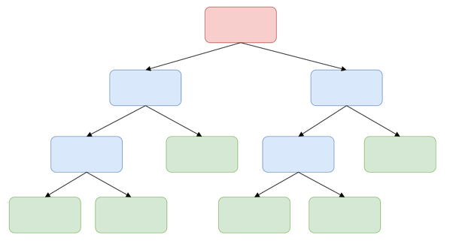
Refining the Guesses (contd.)
Step 2: Run all the data down all of the trees
Running through Tree 1:
Notice that Sample 3 and Sample 4 both ended up at the same leaf node, i.e., they are similar
Sample 3
Sample 1
Sample 2
Sample 4

Slide 23
Proximity Matrix
To keep track of similar samples
Since Sample 3 and Sample 4 are similar, we put 1 in the positions representing pairs of samples 3 and 4
Since no other samples ended in the same leaf node, the proximity matrix result in this after running the samples through the first tree
Sample | 1 | 2 | 3 | 4
1
2
3 |  |  |  | 1
4 |  |  | 1

Slide 24
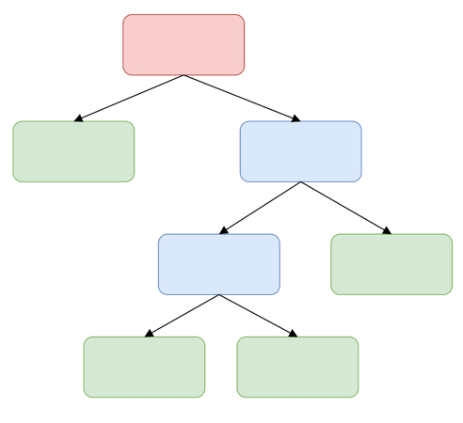
Running through Tree 2…
Notice that Sample 2, Sample 3 and Sample 4 all three ended up at the same leaf node, i.e., they are similar
Sample 3
Sample 1
Sample 2
Sample 4

Slide 25
Update Proximity Matrix
After running down Tree 2
Similarly, after running down Tree 3 (only samples 3 and 4 in the same leaf node)
Sample | 1 | 2 | 3 | 4
1
2
3 |  |  |  | 1
4 |  |  | 1
Sample | 1 | 2 | 3 | 4
1
2 |  |  | 1 | 1
3 |  | 1 |  | 2
4 |  | 1 | 2
update
Sample | 1 | 2 | 3 | 4
1
2 |  |  | 1 | 1
3 |  | 1 |  | 2
4 |  | 1 | 2
Sample | 1 | 2 | 3 | 4
1
2 |  |  | 1 | 1
3 |  | 1 |  | 3
4 |  | 1 | 3
update

Slide 26
After running through 10 trees…
Final updated proximity matrix:
Step 3: Divide each proximity value by the total number of trees
Sample | 1 | 2 | 3 | 4
1 |  | 2 | 1 | 1
2 | 2 |  | 1 | 1
3 | 1 | 1 |  | 8
4 | 1 | 1 | 8
Sample | 1 | 2 | 3 | 4
1 |  | 0.2 | 0.1 | 0.1
2 | 0.2 |  | 0.1 | 0.1
3 | 0.1 | 0.1 |  | 0.8
4 | 0.1 | 0.1 | 0.8

Slide 27

Step 4: Update the missing values
Blocked Arteries:
Yes → 1/3, No → 2/3
ChestPain | Good Blood Circ. | Blocked Arteries | Weight | Heart Disease
No | No | No | 125 | No
Yes | Yes | Yes | 180 | Yes
Yes | Yes | No | 210 | No
Yes | No | ??? | ??? | No
$$\text{Weight} \text{for}\text{ “}\text{Yes}\text{” }=\frac{Proximity of "Yes"}{All Proximities}=\frac{0.1}{0.1+0.1+0.8}=0.1$$
Weighted frequency for “Yes”$=\frac{1}{3}×0.1=0.03$
$$\text{Weight} \text{for}\text{ “}\text{No}\text{” }=\frac{Proximity of "No"}{All Proximities}=\frac{0.1+0.8}{0.1+0.1+0.8}=0.9$$
Weighted frequency for “No”$=\frac{2}{3}×0.9=0.6$
“No” wins since it has higher weighted frequency!
Sample | 1 | 2 | 3 | 4
1 |  | 0.2 | 0.1 | 0.1
2 | 0.2 |  | 0.1 | 0.1
3 | 0.1 | 0.1 |  | 0.8
4 | 0.1 | 0.1 | 0.8

Slide 28
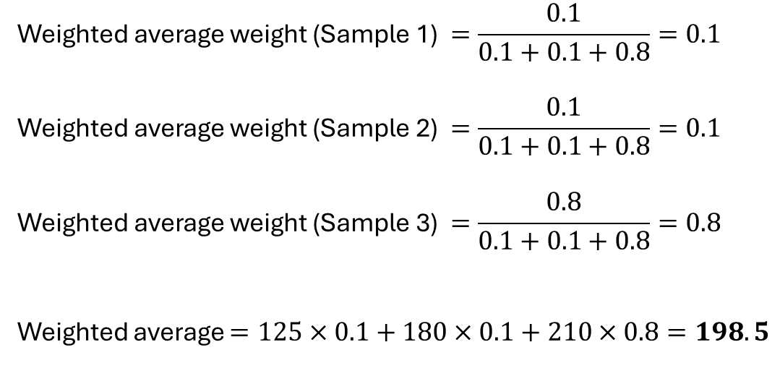
Step 4: Update the missing values
Weight:
ChestPain | Good Blood Circ. | Blocked Arteries | Weight | Heart Disease
No | No | No | 125 | No
Yes | Yes | Yes | 180 | Yes
Yes | Yes | No | 210 | No
Yes | No | ??? | ??? | No
$$\text{Weighted} \text{average} \text{weight}\text{ (}\text{Sample}\text{ 1) }=\frac{0.1}{0.1+0.1+0.8}=0.1$$
$$\text{Weighted} \text{average} \text{weight}\text{ (}\text{Sample}\text{ 2) }=\frac{0.1}{0.1+0.1+0.8}=0.1$$
$$\text{Weighted} \text{average} \text{weight}\text{ (}\text{Sample}\text{ 3) }=\frac{0.8}{0.1+0.1+0.8}=0.8$$
Weighted average $=125×0.1+180×0.1+210×0.8=198.5$
Sample | 1 | 2 | 3 | 4
1 |  | 0.2 | 0.1 | 0.1
2 | 0.2 |  | 0.1 | 0.1
3 | 0.1 | 0.1 |  | 0.8
4 | 0.1 | 0.1 | 0.8

Slide 29
Step 4: Revised Table
ChestPain | Good Blood Circ. | Blocked Arteries | Weight | Heart Disease
No | No | No | 125 | No
Yes | Yes | Yes | 180 | Yes
Yes | Yes | No | 210 | No
Yes | No | No | 198.5 | No
We have revised our guesses once.
Step 5: Repeat the same procedure (i.e., build a random tree with the revised dataset, recalculate the proximities and recalculate the missing values) until the missing values converge (i.e., no longer change each time recalculated)

Slide 30
Missing Data in a New Sample
Suppose we already have built a Random Forest (10 decision trees in the forest) using the existing data
Now we want to classify a new patient if he/she has heart disease or not:
ChestPain | Good Blood Circ. | Blocked Arteries | Weight | Heart Disease
Yes | No | ??? | 168 | ???

Slide 31
Step 1: Create two copies
Copy#1: Has heart disease
Copy#2: Does not have heart disease
ChestPain | Good Blood Circ. | Blocked Arteries | Weight | Heart Disease
Yes | No | ??? | 168 | Yes
ChestPain | Good Blood Circ. | Blocked Arteries | Weight | Heart Disease
Yes | No | ??? | 168 | No

Slide 32
Step 2: Update the missing values
Update the missing value iteratively (as discussed in previous slides 4-15) using Copy#1:
Update the missing value iteratively (as discussed in previous slides 4-15) using Copy#2:
ChestPain | Good Blood Circ. | Blocked Arteries | Weight | Heart Disease
Yes | No | Yes | 168 | Yes
ChestPain | Good Blood Circ. | Blocked Arteries | Weight | Heart Disease
Yes | No | No | 168 | No

Slide 33
Step 3: Run both the options through all the trees in the Random Forest
After running updated Copy#1, suppose it was correctly labeled in 7 out of 10 trees
After running updated Copy#2, suppose it was correctly labeled in 3 out of 10 trees
ChestPain | Good Blood Circ. | Blocked Arteries | Weight | Heart Disease
Yes | No | Yes | 168 | Yes
ChestPain | Good Blood Circ. | Blocked Arteries | Weight | Heart Disease
Yes | No | No | 168 | No

Slide 34
Step 4: Vote
Since the updated Copy#1 was correctly labeled in 7 out of 10 trees, this option wins
We have now not only filled the missing data from the input sample, but we also have classified the sample
ChestPain | Good Blood Circ. | Blocked Arteries | Weight | Heart Disease
Yes | No | Yes | 168 | Yes

